Slide 1
Mountain Waves: Forecasting & Tools for Pilot Preparedness
Sarah Rogowski
Meteorologist, NWS CWSU Salt Lake City
Scott Birch
Regional Aviation Meteorologist, NWS Western Region Headquarters

Slide 2
Mountain Waves Can Ruin Your Flight
Visual Indicators
Types of Waves
Downslope Winds
PIREPs

Slide 3
Mountain Wave Visual Indicators
Lenticular
Cap
Rotor

Slide 4
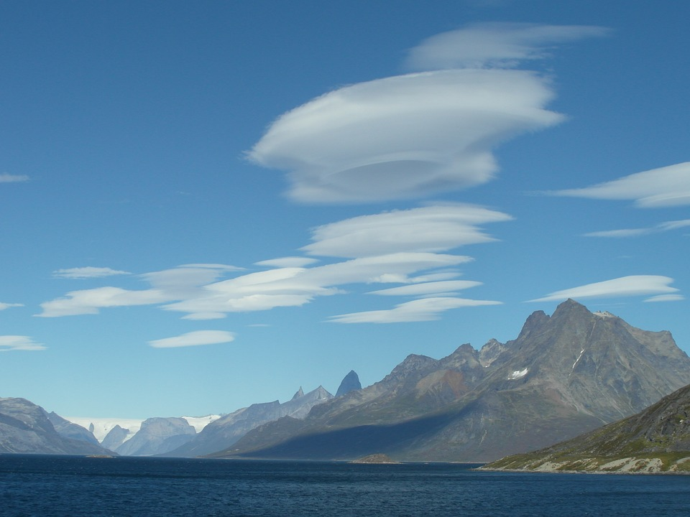
Mountain Wave Visual Indicators Lenticular Clouds
Form near crests of mountain waves.
As air ascends and cools, moisture condenses and the cloud forms.
As that air descends in the lee of the wave crest, the cloud evaporates.
Air flows through the cloud while the cloud itself is relatively stationary, hence “standing lenticulars.”

Slide 5
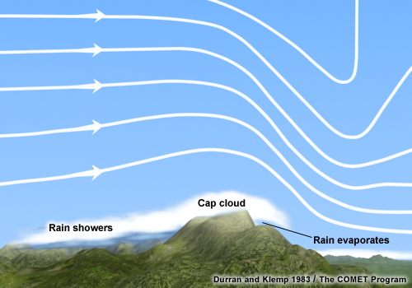
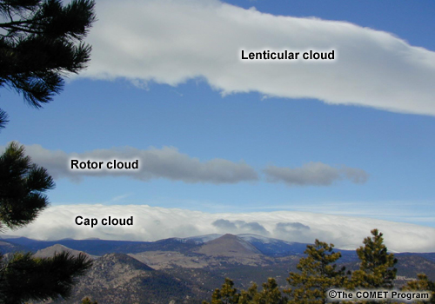
Mountain Wave Visual Indicators: Cap Clouds
Heavy precipitation often occurs on the upwind side of the barrier.
Viewed from downstream, cap clouds can appear as a wall of clouds hanging over the ridge top.

Slide 6
Mountain Wave Visual Indicators: Rotors & Rotor Clouds
Typically occur at or below mountain-top level and within 20NM of the ridge line.
Cloud found near the top of the rotor circulation and under higher lenticular clouds.
Contains strong turbulence and should be avoided by pilots.

Slide 7
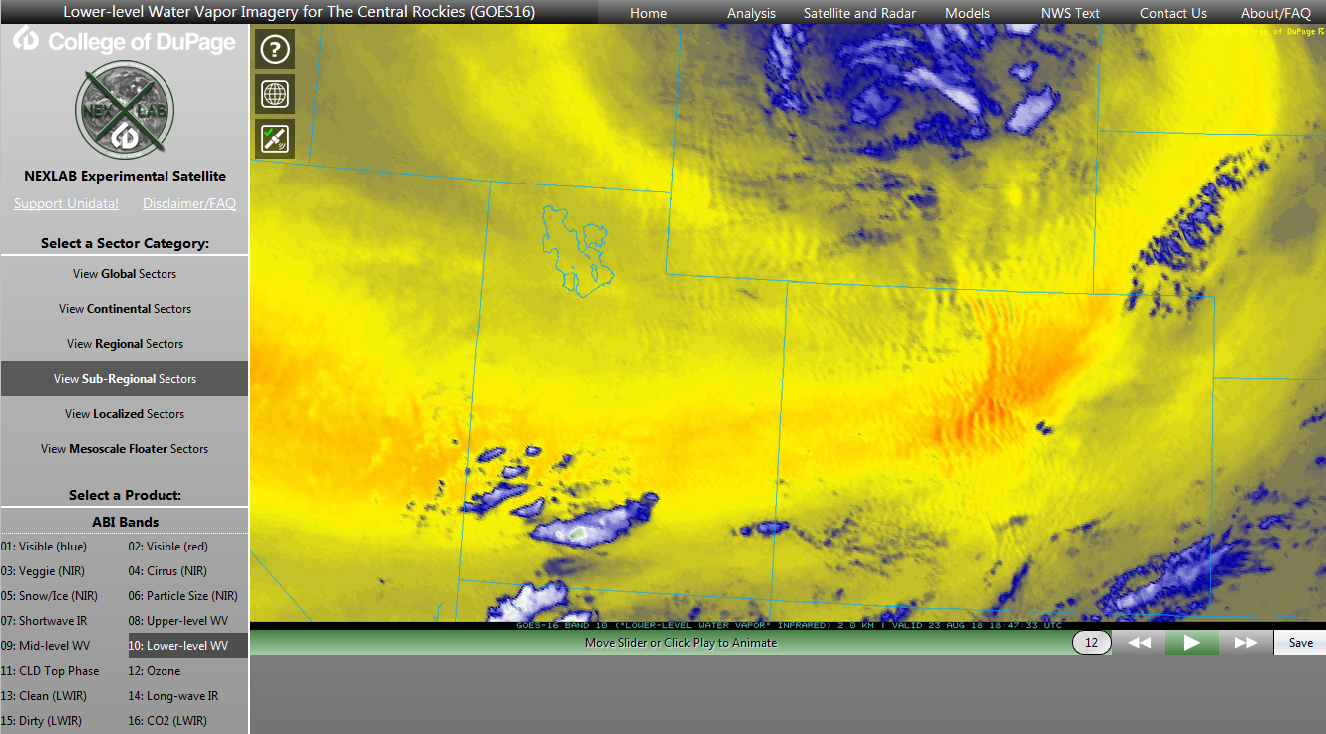
GOES-R Satellite Capabilities
A wider array of satellite channels with GOES-R can help detect mountain waves.
Looping the image helps display clouds that are “locked” to the mountains and advect only in the downstream direction

Slide 8
Types of Waves
Vertically Propagating Waves
Breaking Waves
Trapped Lee Waves

Slide 9
Vertically Propagating Waves
Can produce turbulence at very high altitudes - waves documented up to 200,000 feet and higher.
Causes Clear air turbulence (CAT)
Often most severe within the first wavelength downwind of the mountain barrier.

Slide 10
Breaking Waves
Vertically-propagating waves with sufficient amplitude may break, and can result in severe to extreme turbulence between 20,000 and 40,000 feet
If a vertically-propagating wave doesn't break, an aircraft would likely experience considerable wave action, but little turbulence.

Slide 11
Trapped Lee Waves
Lee waves whose energy does not propagate vertically because of strong wind shear or low stability above are said to be "trapped."
Often found downstream of the rotor zone, although a weak rotor may exist under each lee wave.
Typically within a few thousand feet of the mountain ridge crest

Slide 12
Trapped Lee Waves
Turbulence is generally below 25,000 feet.
Strong turbulence can develop below the lenticular cloud base.

Slide 13
Downslope Winds
Usually associated with breaking waves
In extreme cases, winds can exceed 100 knots (double or triple the wind speed at mountaintop level)
Leads to turbulence and wind shear at the surface.
Often abruptly end at the jump region, although more moderate turbulence can exist downstream.
Jump Region: extremely turbulent area that can extend up to 10,000 feet

Slide 14
Resources for Mountain Wave Forecasts
aviationweather.gov
Forecast -> Turbulence -> GTG
Look for bright colors!
Tools -> GFA Tool -> Winds
Look for cross-barrier (perpendicular) winds at ridge top & jet stream levels
Look for gusty surface winds

Slide 15
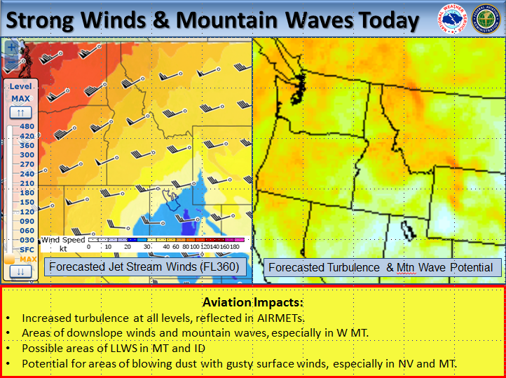
Resources for Mountain Wave Forecasts
weather.gov/zlc
“Weather Story” image on the top right corner
Current Hazards -> CWAs and MISs

Slide 16
Severity of Mountain Waves
No official ICAO criteria for severity!!
Wave Intensity | Up & Down Drafts | Speed Change | Net Altitude Change
Moderate | 350-599 ft/min | +/- 15-24 KT | 500-999 ft
Severe | >=600 ft/min | >= +/- 25 KT | >1000 ft
General criteria developed to create a more consistent forecast/product.
PIREPs with DETAILS are key in providing quality data to pilots!!

Slide 17
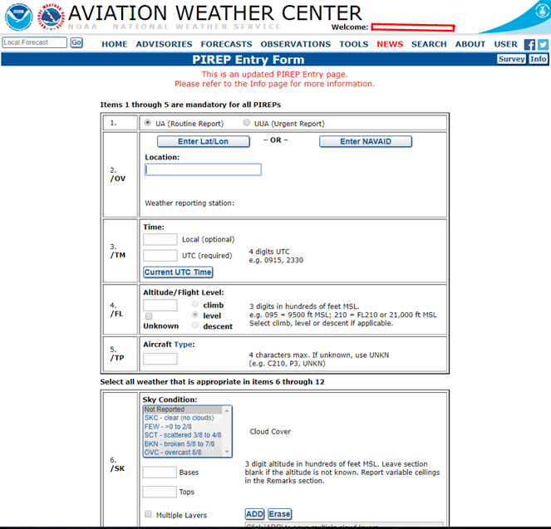
https://aviationweather.gov/pirep/submit
Supported by
AOPA & NTSB
Now includes a Mountain Wave entry option

Slide 18
Mountain Waves Can Ruin Your Flight
Visual Indicators
Types of Waves
Downslope Winds
PIREPs

